Slide 1
NATURAL DISASTERS FACT FILE PROJECT
Worksheets 7 and 8
By Vyom Mahajan
Grade - VIII Whiz – 3
12th September, 2020
Please look at the PPT in slideshow.

Slide 2
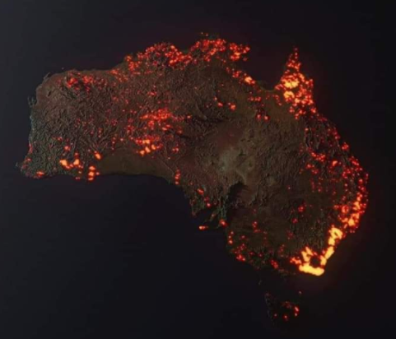
THE AUSTRALIAN BUSH FIRE
Location – All across Australia
Date – From June 2019 to March 2020
Causes – As per the government authorities of Australia
Due to dry lightning storms
Lightning hitting the trees
Effects –
Burnt over 18 million hectares of land
Destroyed over 5,900 buildings
Loss of habitats for billions of animals
Killed many millions of animals
Lowered air quality indexes
The smoke affected New Zealand and few cities in Argentina and Chile
Pollution resulting in the loss of balance of the ecosystems
There was a quick and immense rise in temperature
Disaster Management –
Fire fighters used water – bombing planes and helicopters
There were 3,000 army, navy and air force reservists
3,700 firefighters and support crew
440 emergency personnel
240+ firefighting personnel from USA, Canada and New Zealand
Mass evacuations
No cooking using fire or gas for multiple days to avoid further damage
No arson (When people purposely light the fires for attention)

Slide 3
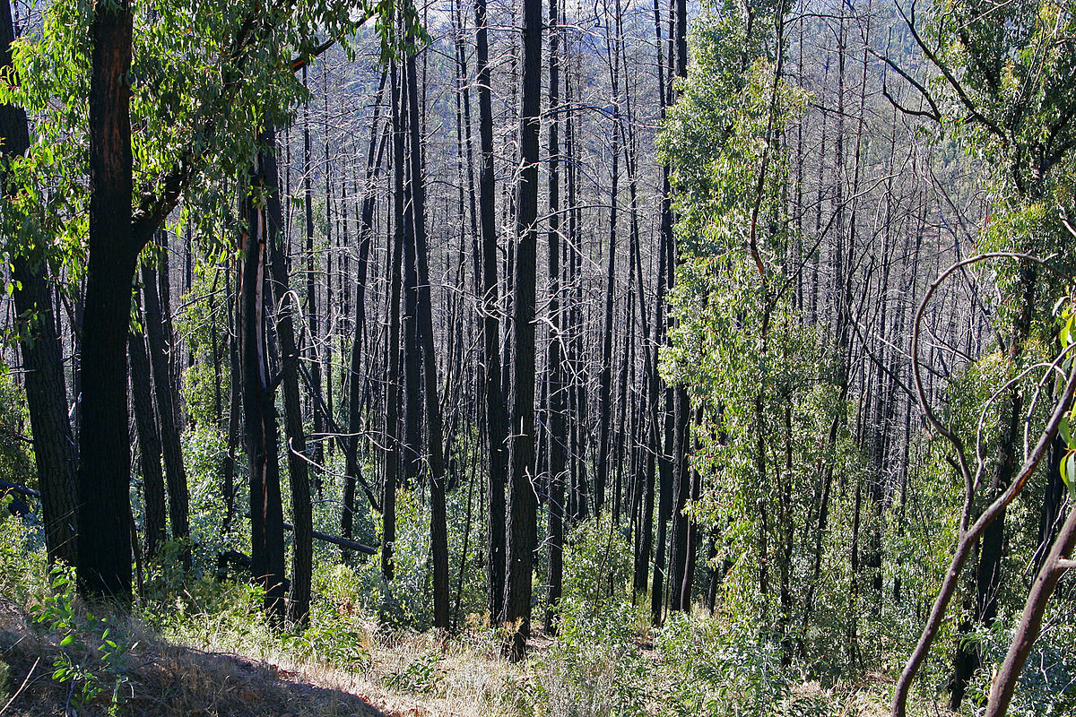
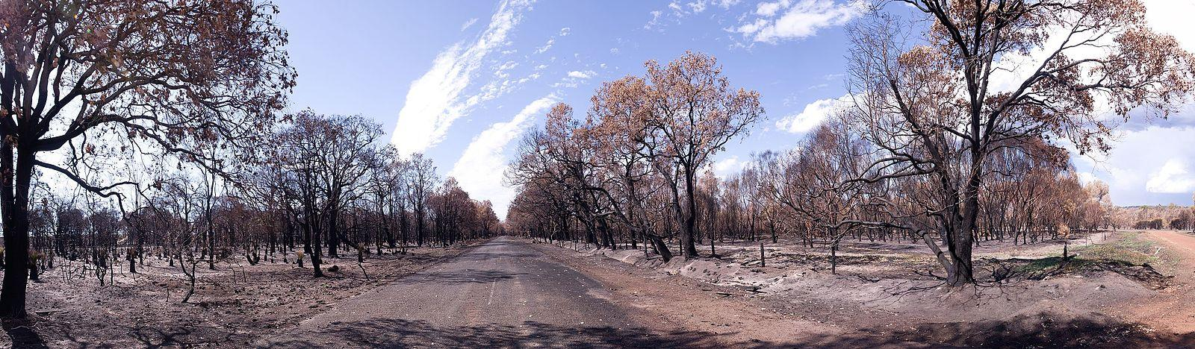
THE AUSTRALIAN BUSH FIRE
Before Fires | After Fires
Other instances of fires –
The Carnarvon bushfire complex in 2012
The 2006 – 07 Australian bushfire season
The Great Divides bushfires from 2006 – 07
Other instances of bush fires documented in Wikipedia -
https://en.wikipedia.org/wiki/List_of_major_bushfires_in_Australia
Reference for causes –
https://www.aph.gov.au/About_Parliament/Parliamentary_Departments/Parliamentary_Library/pubs/rp/rp1920/Quick_Guides/AustralianBushfires#:~:text=On%203%20February%202020%20local,NSW%20were%20caused%20by%20lightning.
https://www.abc.net.au/news/2020-01-11/australias-fires-reveal-arson-not-a-major-cause/11855022
Reference for effects –
https://www.unenvironment.org/news-and-stories/story/ten-impacts-australian-bushfires#:~:text=Physical%2C%20direct%20impacts,reported%20to%20have%20been%20killed.
Reference for Disaster management –
https://www.bbc.com/news/world-australia-51008051

Slide 4
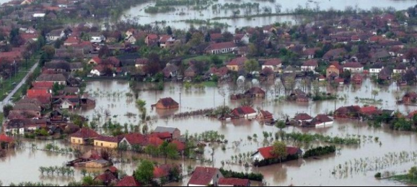
FLOODS IN INDONESIA
Location – Jakarta and neighbouring areas
Date – On 1st January 2020
Causes –
There was immense rainfall in Jakarta
Jakarta is sinking 6 – 10 inches per year
Effects –
Left more than 300 people homeless.
Flood water reached to 5 feet at a few places.
Capital will move from Jakarta to site in East Kalimantan Province, Borneo island
67 people died in the event
Caused landslides, hypothermia, drowning and electrocution
Disaster Management –
Cloud seeding planes were used in an attempt to break the rain
Government buildings and schools used as evacuation shelters.
Public kitchens, healthcare posts, medicines, sleeping mats, public toilets and other basic needs prepared during floods
The Government plans to build dams, infrastructure with anti – flooding methods

Slide 5
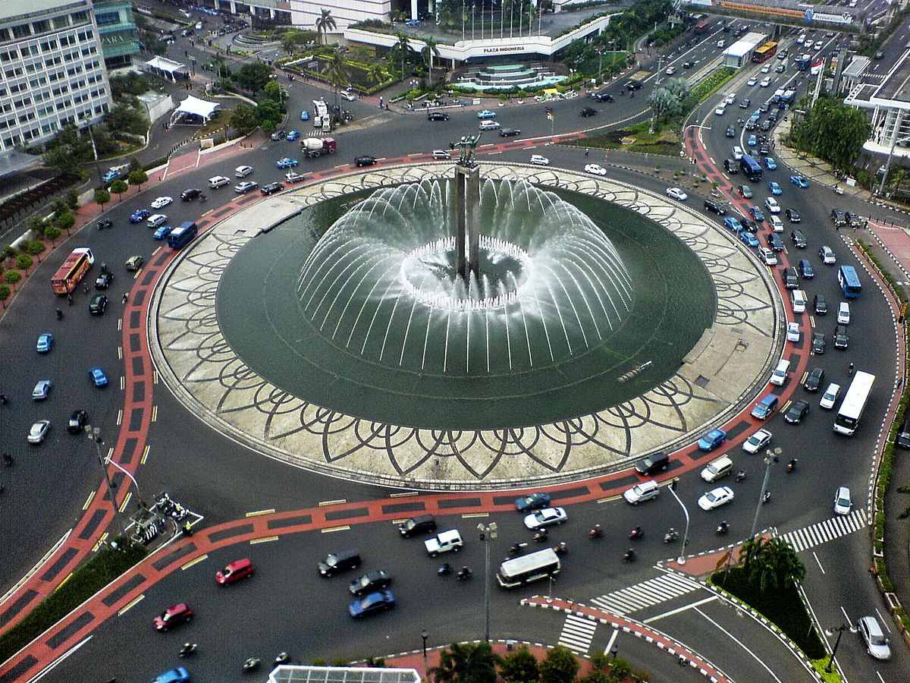
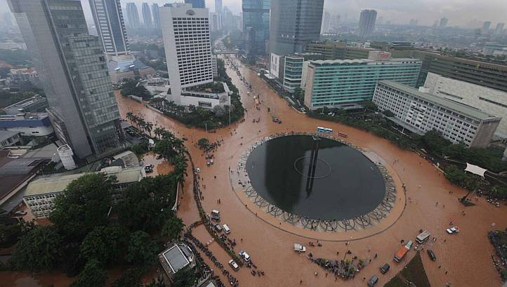
FLOODS IN INDONESIA
Reference for Date, Causes and Disaster Management –
https://en.wikipedia.org/wiki/2020_Jakarta_floods#:~:text=Flash%20floods%20occurred%20throughout%20the,and%20Cisadane%20rivers%20to%20overflow.
Reference for Effects –
https://www.usatoday.com/story/news/world/2020/02/25/jakarta-floods-2020-indonesia-capital/4865913002/
Before Floods | After Floods

Slide 6

THE CORONA VIRUS
Location – Wuhan (Originated), now world wide
Date – The outbreak was first identified in December 2019.
Causes –
Scientists concluded that it was caused naturally
Two scenarios -
The pathogenic version passed from a non – human to a human host (bats to humans)*
A non – pathogenic version got into humans from an animal and turned into its pathogenic state
Effects –
Slowing down of economic growth
People with other diseases, getting neglected
Functioning of schools and colleges impaired
Burden on the healthcare industries to make sanitizers, masks and other necessities
Depression and other psychological disorders.
Disaster Management –
Caused a lockdown in most of the countries
Social distancing, i.e., 6 feet distance between person to person
Restaurants, malls, theatres, entertainment centres closed to avoid crowding of people
*This is how previous Coronavirus outbreaks occurred.

Slide 7
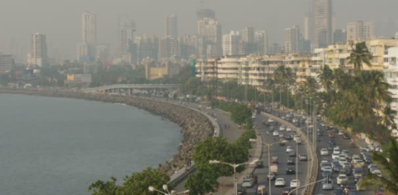
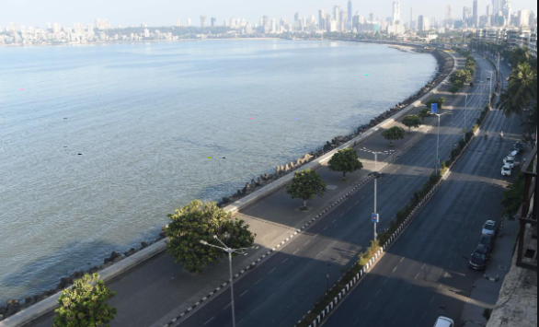
THE CORONA VIRUS
Reference for date –
https://en.wikipedia.org/wiki/COVID-19_pandemic
Reference for Causes –
https://www.sciencedaily.com/releases/2020/03/200317175442.htm
Reference for Effects and Disaster Management –
https://www.ncbi.nlm.nih.gov/pmc/articles/PMC7147210/
Before COVID-19 | During COVID-19

Slide 8
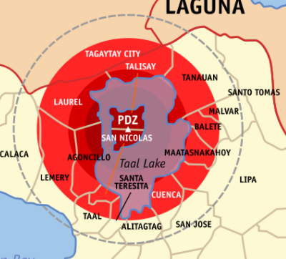
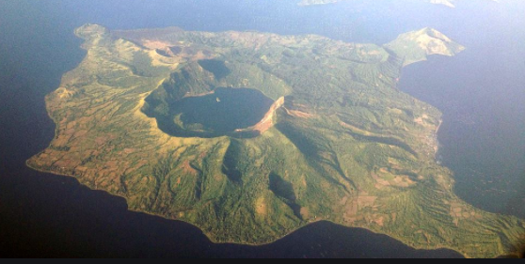
VOLCANO ERUPTION IN PHILIPPINES
Location – Batangas, Philippines
Date – On 12th January, 2020
Causes –
The interaction between magma and water took place
It was a phreatomagmatic eruption
Effects –
Many animals were killed
Ash clouds hung over the volcano
Air quality reduced
Less drinking water
People had to live with relatives and stay away from their houses
At least 8,46,000 were affected
Disaster Management -
People maintained alert level 4 in January
Alert level* 2 was maintained by March
Shelter in 13 evacuation centres in Batangas and Quezon provinces
*
Alert level 5 – Hazardous eruption in progress
Alert level 4 – Eruption could occur in few days
Alert level 3 – Eruption hazards near vents
Alert level 2 – Less eruption hazards
Alert level 0/1 – Very less or no eruption hazards

Slide 9
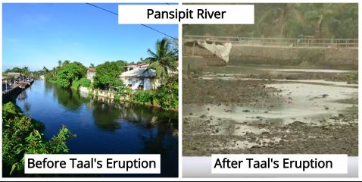
VOLCANO ERUPTION IN PHILIPPINES
Reference for Location and Date –
https://en.wikipedia.org/wiki/2020_Taal_Volcano_eruption#:~:text=The%20volcano%20erupted%20on%20the,Time%20(UTC%2B8)
Reference for Causes –
https://en.wikipedia.org/wiki/2020_Taal_Volcano_eruption
Reference for Effects –
https://reliefweb.int/report/philippines/volcano-eruption-humanity-inclusion-assesses-needs-those-affected#:~:text=The%20damage%20caused%20by%20the,drinking%20water%20and%20air%20quality
Reference for Disaster Management –
https://reliefweb.int/disaster/vo-2020-000002-phl
Before Eruption | After Eruption

Slide 10
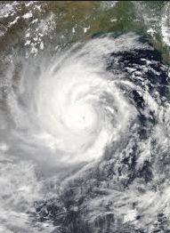
CYCLONE AMPHAN
Location – India (West Bengal, Odisha, Andaman & Nicobar islands), Bangladesh, Sri Lanka and Bhutan
Date – From 16th May 2020 to 21st May 2020
Causes –
On 13th May an area of low pressure developed in the Bay of Bengal
On 16th May the low pressure region developed into a depression
It moved northwards for a few hours and developed into a cyclonic storm
Effects –
Many people died
Left a lot of people homeless
Damaged power and telecom infrastructure in many coastal districts
Heavy rains in coastal areas
Loss of lot of marine animals
Triggered floods and landslides
Disaster Management –
Affected areas were given money by the government
Power was slowly restored to these affected areas
The Indian army was called to help the people in the affected areas
The Ministry of Disaster Management and Relief in Bangladesh distributed gloves, masks and sanitizers in a few districts

Slide 11
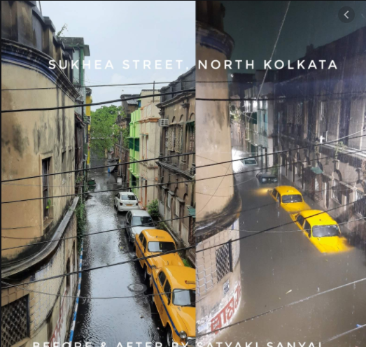
CYCLONE AMPHAN
Before the Cyclone | After the Cyclone
Reference for all of the topics –
https://en.wikipedia.org/wiki/Cyclone_Amphan

Slide 12
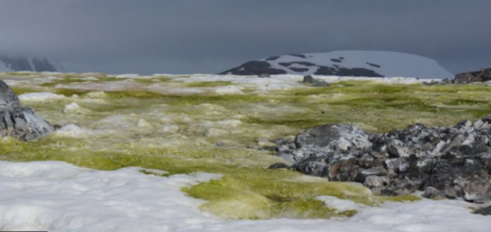
SNOW TURNS GREEN
Location – Antarctica
Date – Going on since many years
Causes –
Global warming
Warmest temperature on Antarctica – 20 degrees Celsius
Growth of algae, conditions good enough for growth –
Water just above freezing point
Snow gets the right slushiness
Effects –
1679 algal blooms observed till date
Holds lot of dry biomass
The algae is like a carbon sink absorbing about 500 tons of Carbon di Oxide
Absorbs more heat from sun due to photosynthesis –
Ice will start melting faster
Disaster Management –
Take measures to prevent global warming

Slide 13
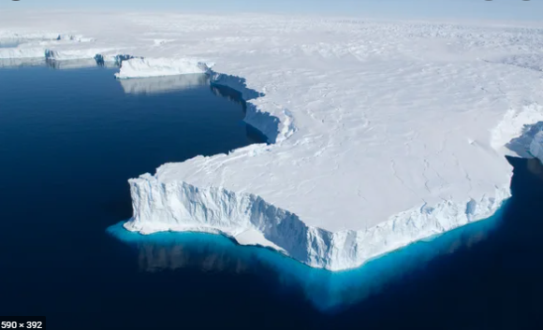
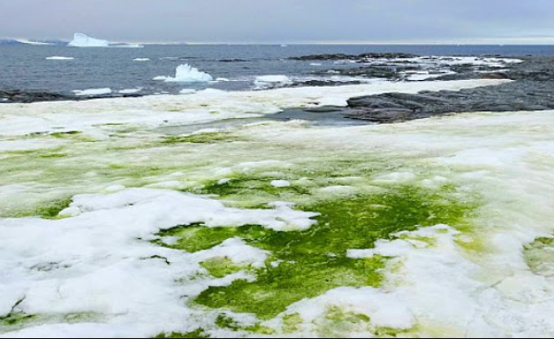
SNOW TURNS GREEN
References for all of the topics –
https://theprint.in/environment/antarcticas-snow-is-turning-green-while-we-are-distracted-by-a-coronavirus/431643/#:~:text=And%20that's%20happening%20with%20increasing,act%20as%20a%20carbon%20sink.
https://www.geographyrealm.com/why-is-antarcticas-snow-turning-green/
https://barrie360.com/climate-change-is-causing-antarcticas-snow-to-turn-green-study/
Before algal blooms | After algal blooms

Slide 14
THANK YOU FOR READING.

